Slide 1
Linear Algebra
Lecture 16

Slide 2
Matrix
Algebra

Slide 3
Iterative Solutions
of Linear Systems

Slide 4
Iterative Solution
Linear systems are solved either by direct calculation (e.g. a matrix factorization) or by an iterative procedure, generating a sequence of vectors approaching the exact solution.

Slide 5
When the coefficient matrix is large and sparse, iterative algorithms can be more rapid than direct methods and can require less computer memory.

Slide 6
Also, an iterative process may be stopped as soon as an approximate solution is sufficiently accurate for practical work.

Slide 7
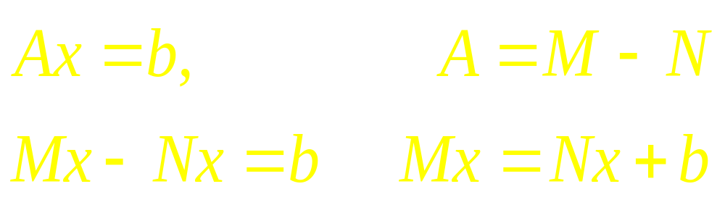
General Framework

Slide 8
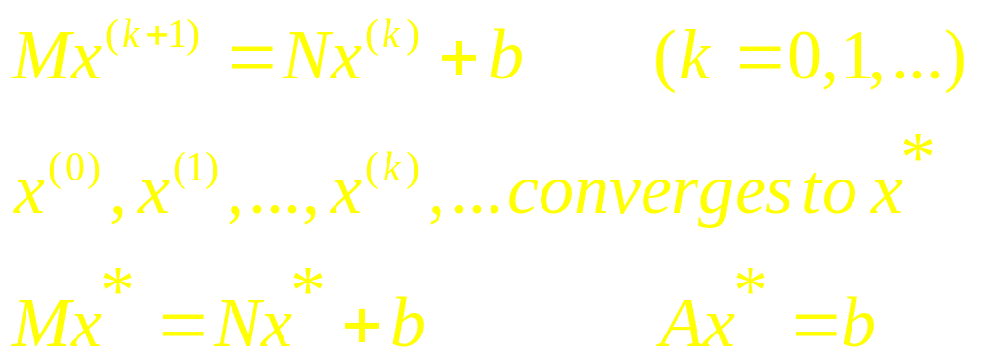
General Framework

Slide 9
Jacobi's Method
This method assumes that the diagonal entries of A are all nonzero. Let D be the diagonal matrix formed from the diagonal entries of A. Jacobi’s method uses D for M and D – A for N

Slide 10
Continued
In a real-life problem, available information may suggest a value for x⁽⁰⁾ . For simplicity, we take the zero vector as x⁽⁰⁾ .

Slide 11
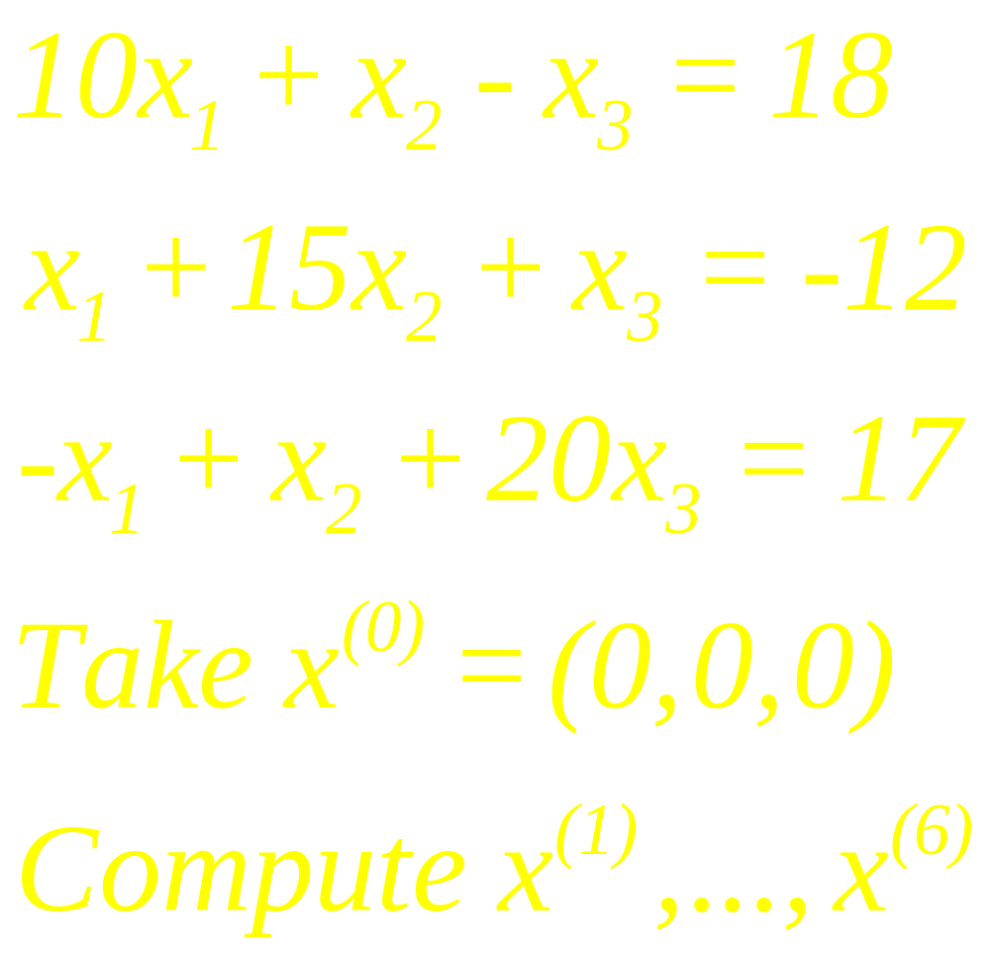
Example 1

Slide 12
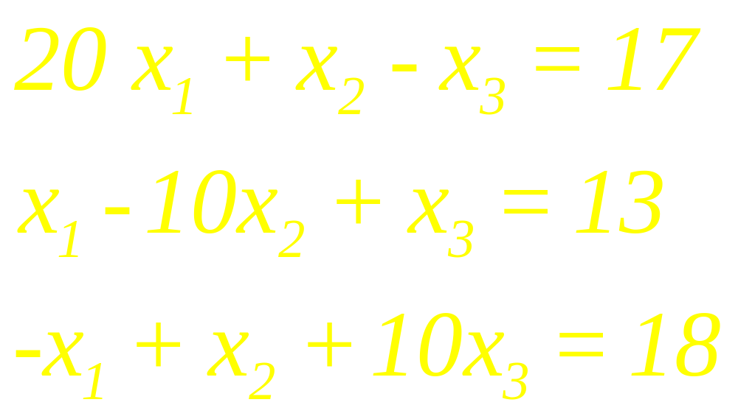
Example 2
Stop the process when the entries in two successive iterations are the same when rounded to four decimal places.

Slide 13
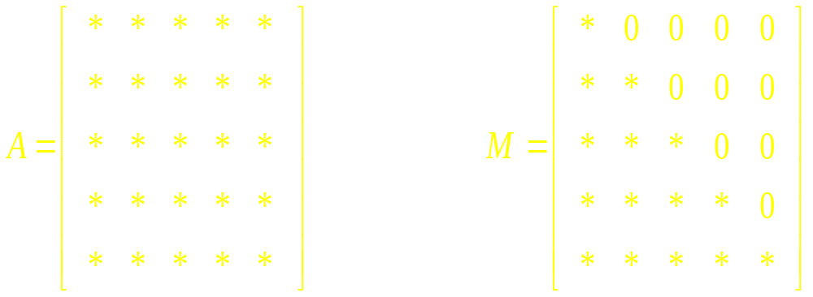
Gauss-Seidel Method

Slide 14
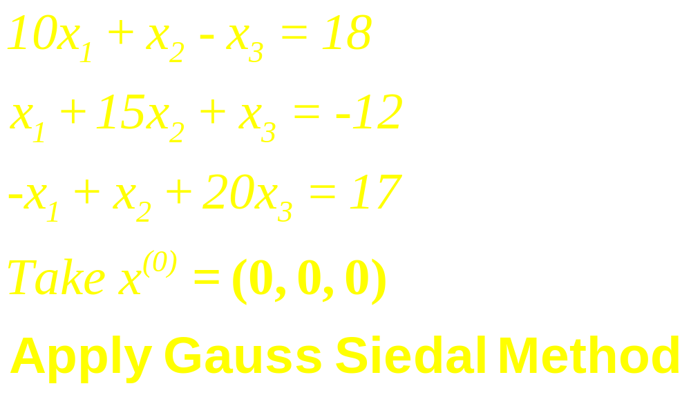
Example 3

Slide 15
Example 4
Use Gauss-Siedal Method to Solve

Slide 16
Definition
A matrix A is said to be strictly diagonally dominant if the absolute value of each diagonal entry exceeds the sum of the absolute values of the other entries in the same row

Slide 17
Remarks
If A is strictly diagonally dominant, then A is invertible and both the Jacobi and Gauss-Seidel sequences converge to the unique solution of Ax = b, for any initial .

Slide 18
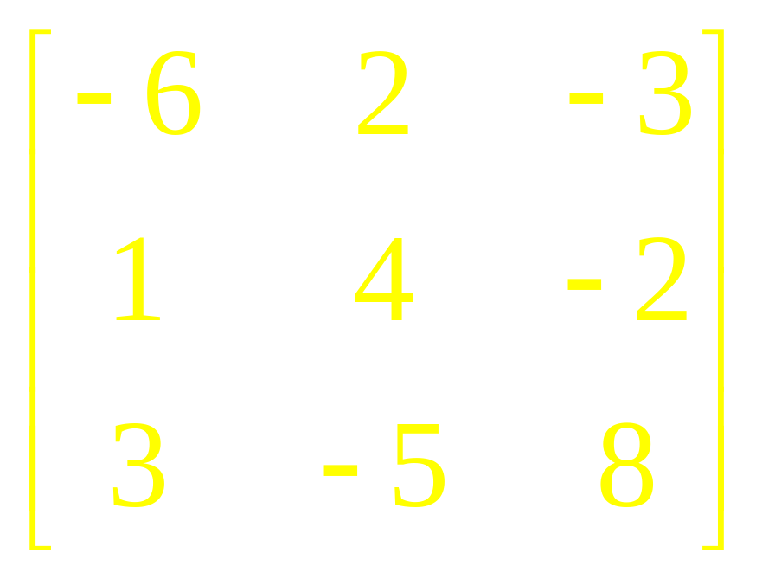
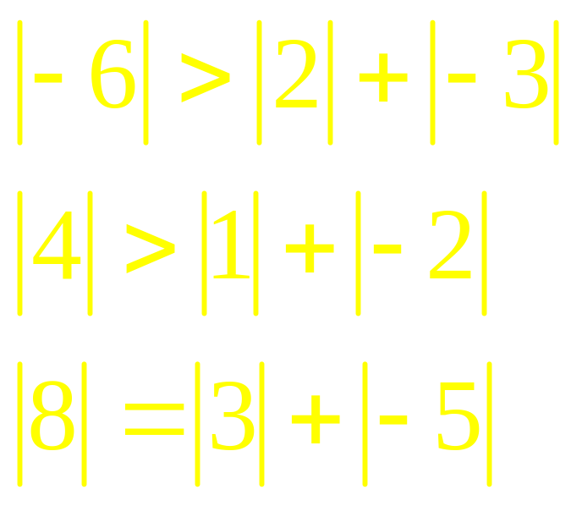
Example
The following matrix is not

Slide 19
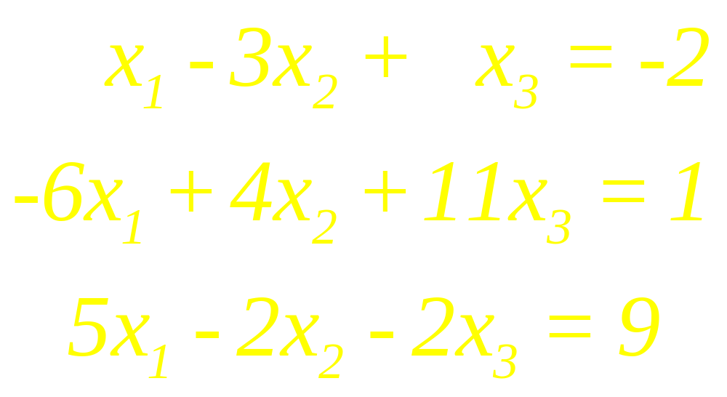
Example 5
Solve the following system by Gauss-Seidel method

Slide 20
Linear Algebra
Lecture 16

